Slide 1

Mahindra First Choice Services Report
Created by:
Cyberbots

Slide 2
Problem Statement
Geo location Based Analysis
Generate meaningful insights on Geolocation based customer & revenue analysis
Market Segmentation
Divide the customer base into segments based on their car type, service type & total spend such that these customers will respond similarly to the different marketing campaigns.
Customer Lifetime Value Prediction
Life time value analysis of customers to maintain relationship with high profit generating customers in future & finding potential customers from the population.

Slide 3
Datasets
Customers
Invoice
Inventory
Row – 555338
Column – 9
4/9 Columns having 90% + null values
Row – 492314
Column – 58
7/58 Columns having 90% + null values
30/58 Columns having 40% + null values
25/58 Columns having single/null values
Row – 5619484
Column – 9
1/9 Columns having 67% null values
8/9 Columns having >1% null values
Dataset is provided in excel and csv format

Slide 4
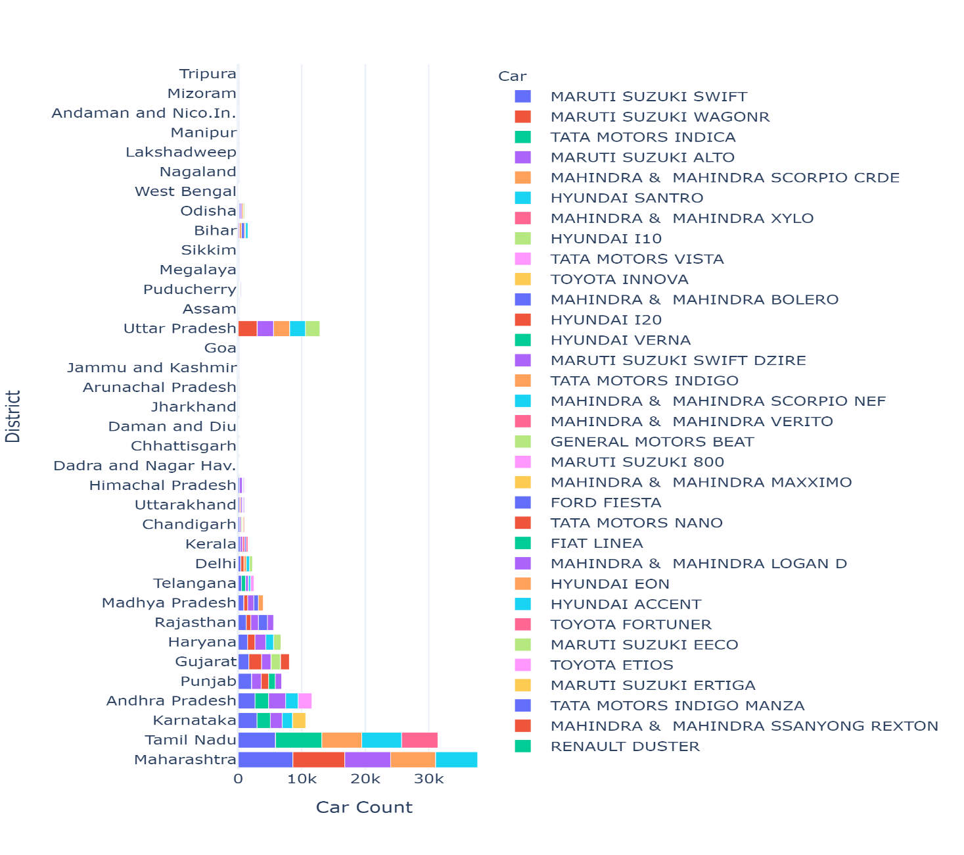
Problem Statement 1 : Identifying the ownership pattern
This chart depicts car count by each state
90% of the car belongs to first 10 States
Chart suggest that economical cars are most popular
Avigo, Z4, Pushpak, Estilo, Trailblazer are least owned cars at count of 1

Slide 5
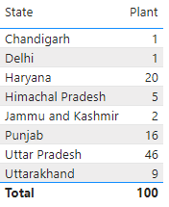
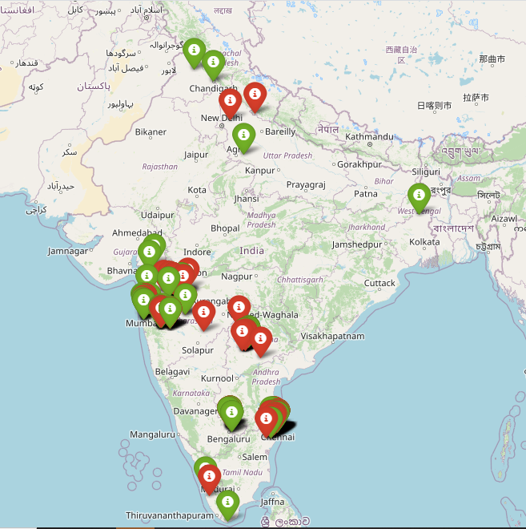
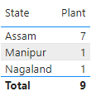
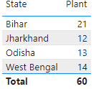
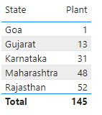
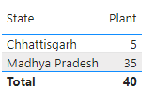
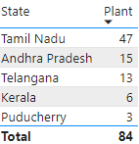
Plant Analysis

Slide 6
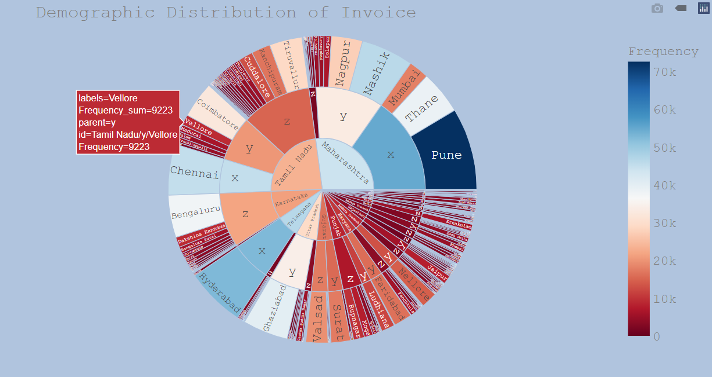
Customer Analysis
Customer Analysis

Slide 7
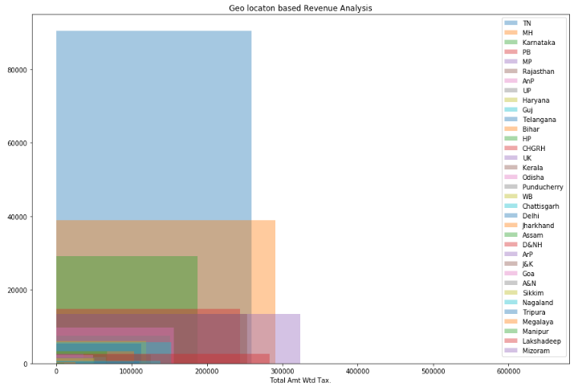
State wise revenue generation
Tamilnadu has highest customer base followed by Maharashtra.
Top 3 revenue generating states are
Pondicherry
Maharashtra
Tamilnadu

Slide 8
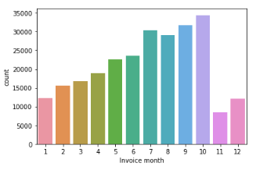
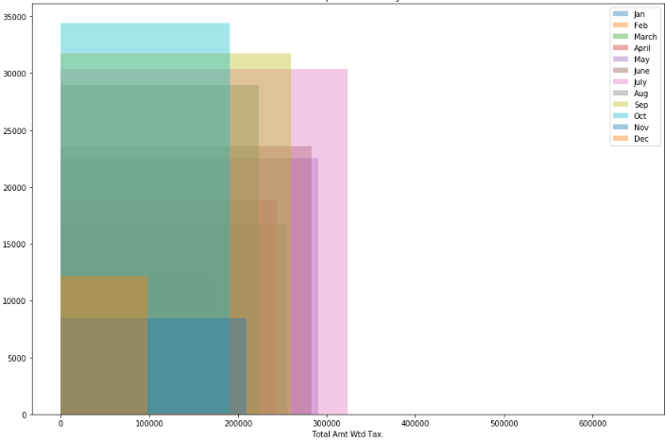
Month wise revenue trend
Observations: Car visits is highest in the month of October though revenue in July month is highest (due to monsoon related servicing)

Slide 9
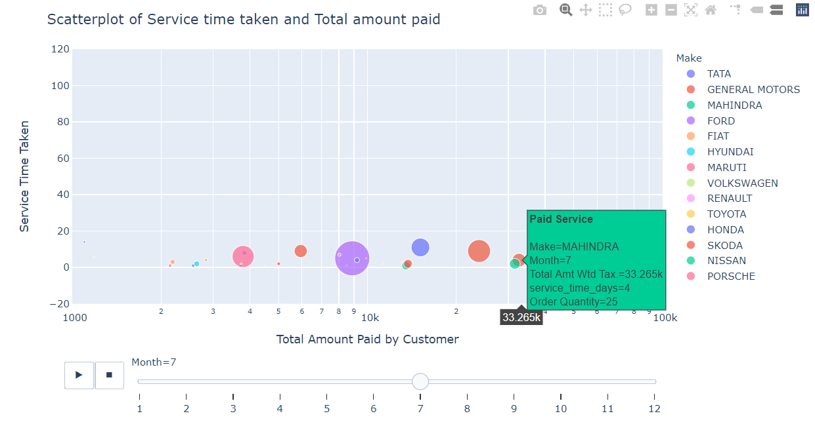
Data Analysis

Slide 10
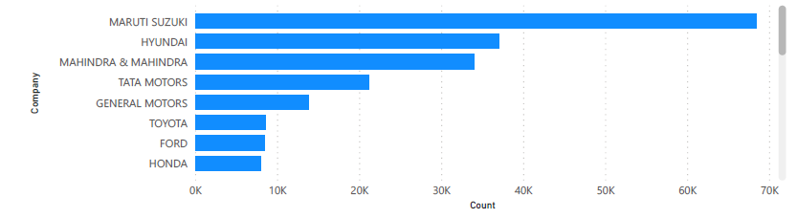
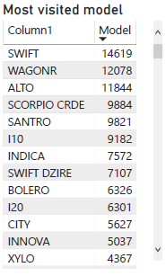
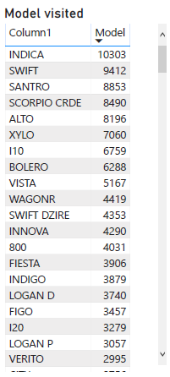
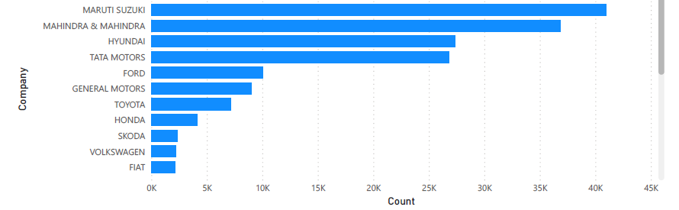
Most visited Cars Companies in Different Zones
Western Zone :
Total Car Companies: 28
Total No. of Car visited to workshop: 211K
Southern Zone
Total Car Companies: 26
Total No. of Car visited to workshop: 172K

Slide 11
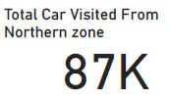
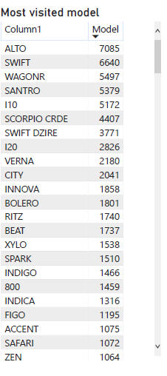
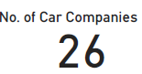
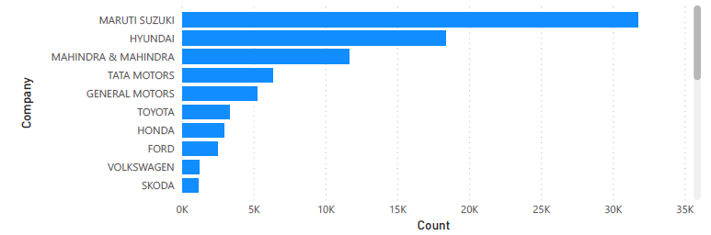
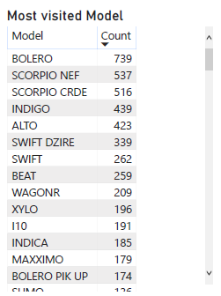
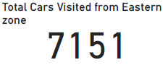
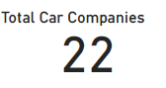
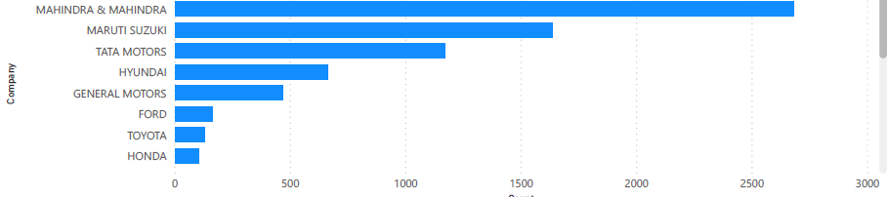
Northern Zone:
Top 10 Companies
Eastern Zone:
Top 8 Companies

Slide 12
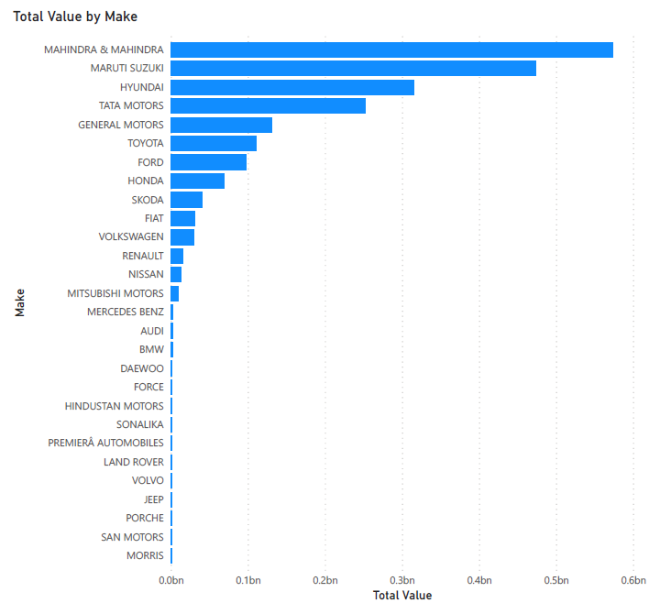
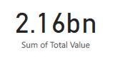
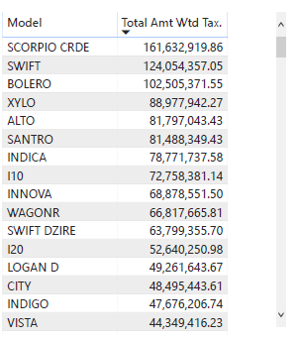
Revenue Based on Make and Model
Total Revenue

Slide 13
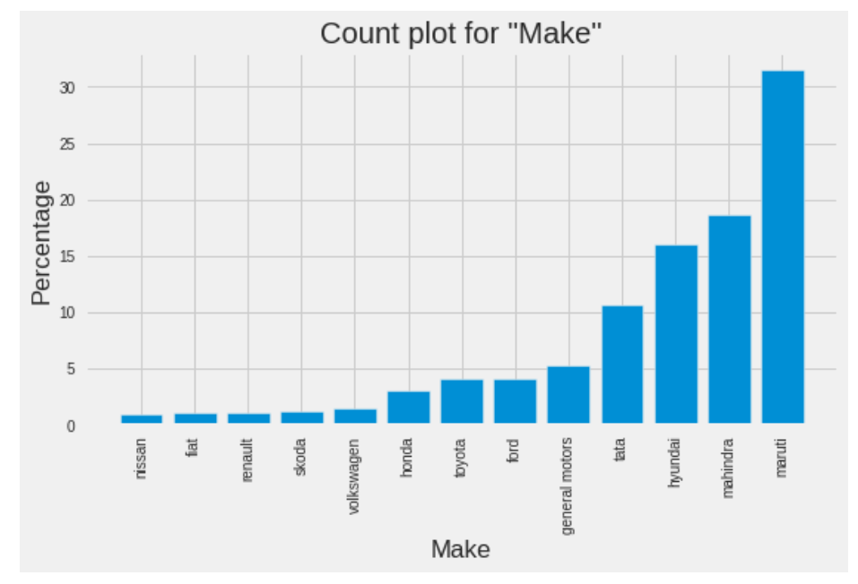
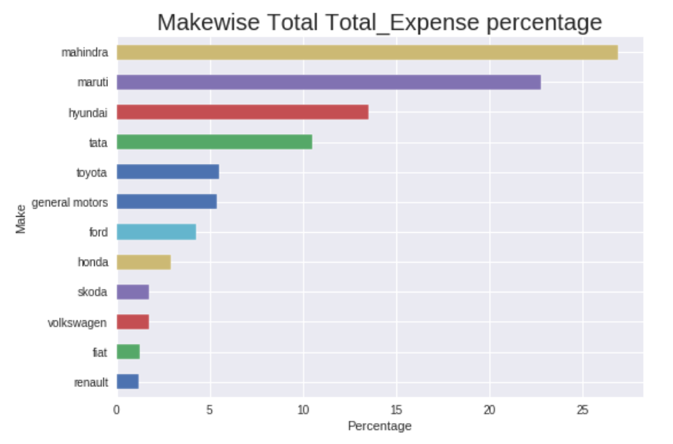
Data Analysis
Observation:
Revenue from ‘Mahindra’ is more though the number of repairs for Maruti is largest

Slide 14
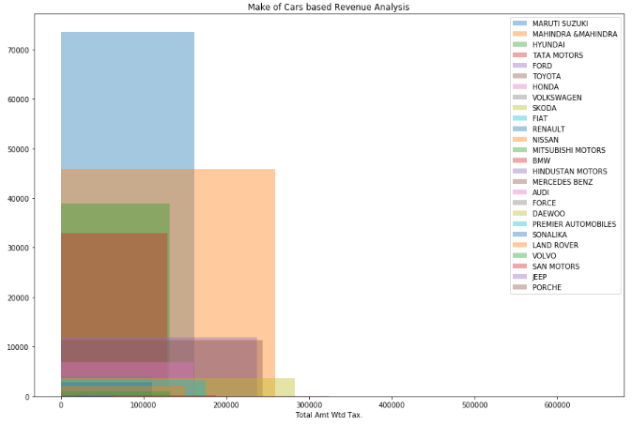
Car make wise revenue trend
Observations ➔
Maruti Cars have highest frequency of visit
Skoda cars generates highest revenue

Slide 15
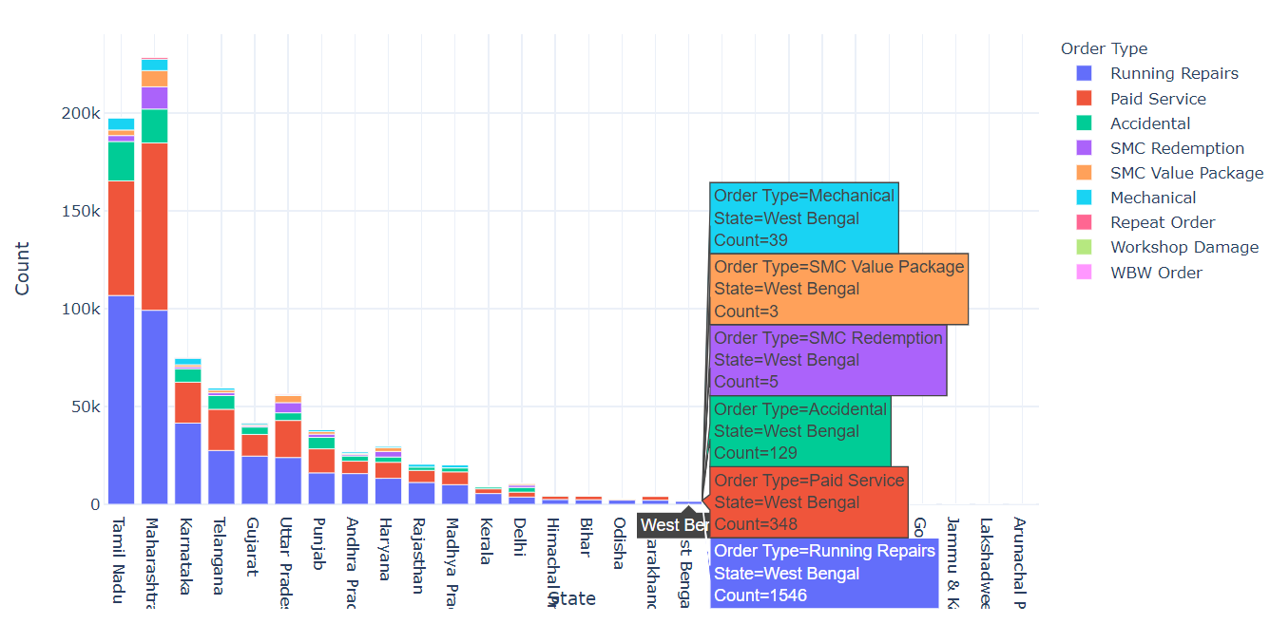
Problem Statement 2 : Identifying Order Type Pattern
Running Repairs & Paid Services are most common among top Manufacturers

Slide 16
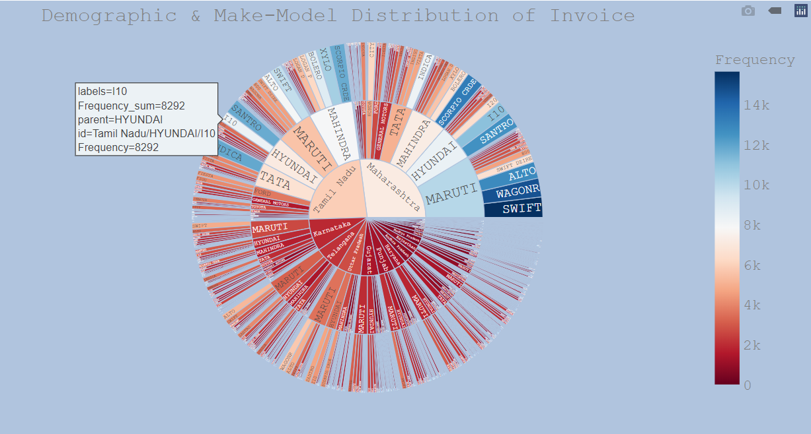
Make-Model Distribution
Make-Model Distribution
Higher demand for ‘Maruti Suzuki’ & ‘Mahindra and Mahindra’ in ‘Tamil Nadu’ and ‘Maharashtra’.

Slide 17
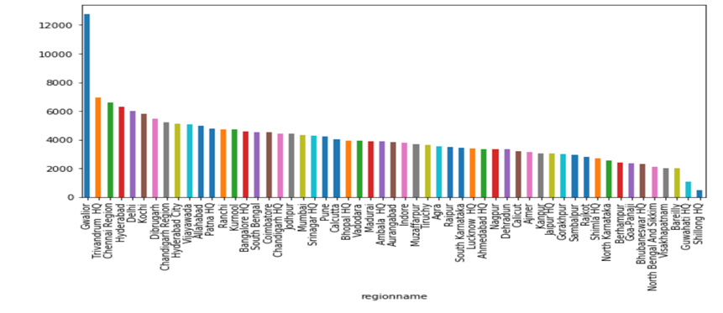
Data Analysis
Data Analysis
City by Average Revenue:
32% services are accidental cases and revenue generated from Gwalior is 94.83% from accidental cases

Slide 18
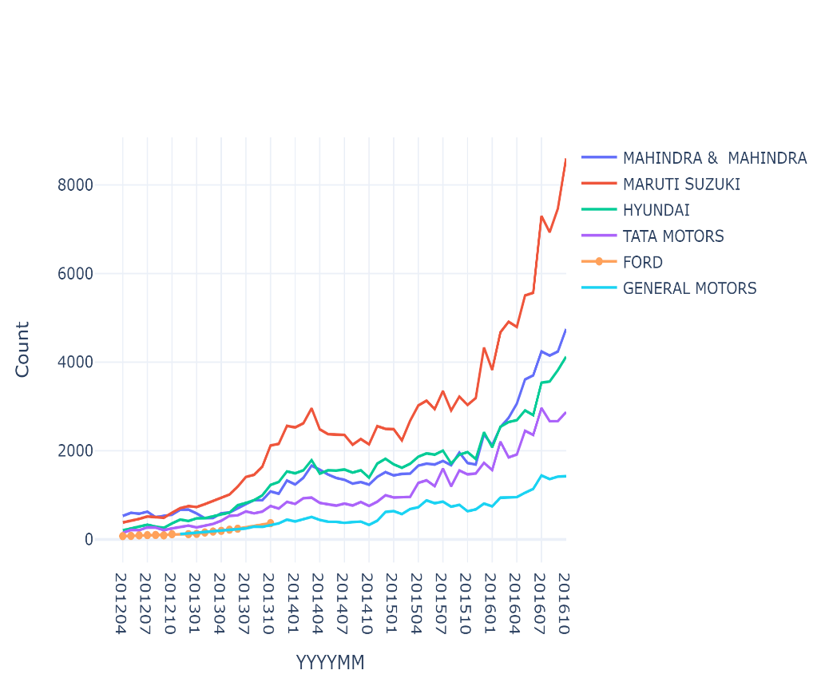
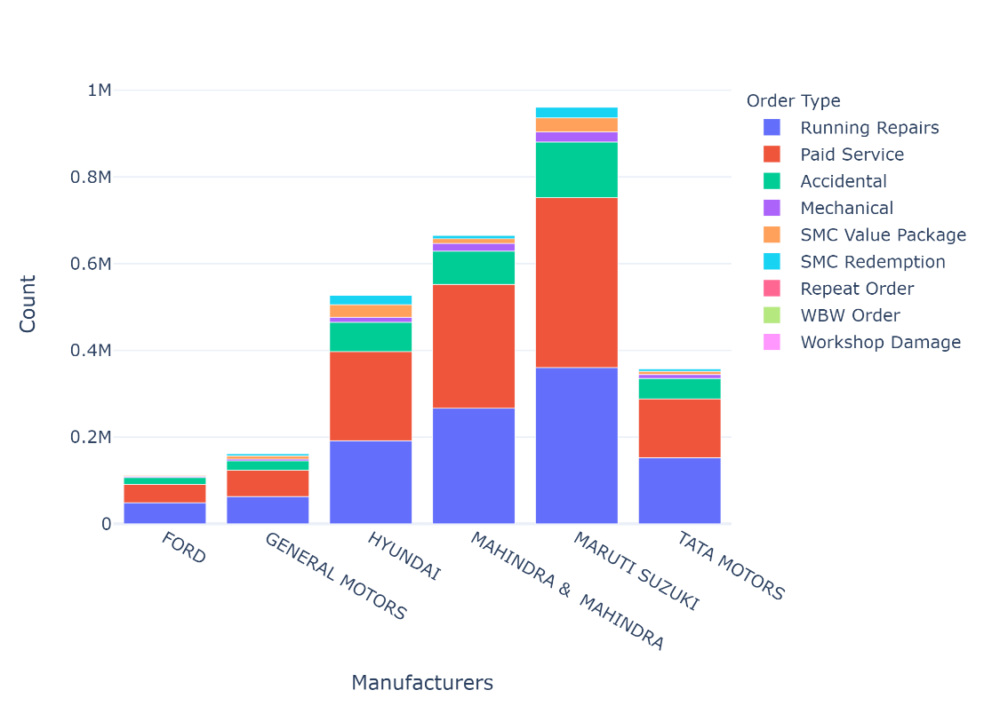
Top Manufacturers & their order type
Running Repairs & Paid Services are most common among top Manufacturers
Ford was 5th ranked car in Most popular car ranking during 2012 and 2013
Since General Motors has taken its place

Slide 19
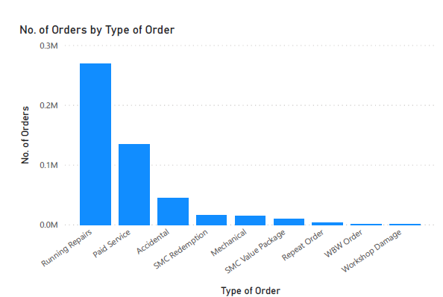
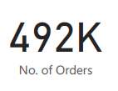
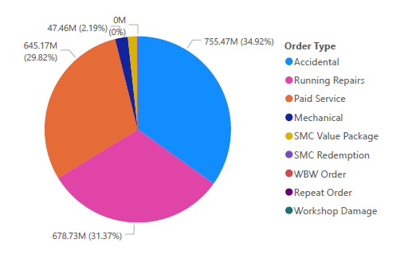
Revenue Based On Order Type
Total Revenue

Slide 20
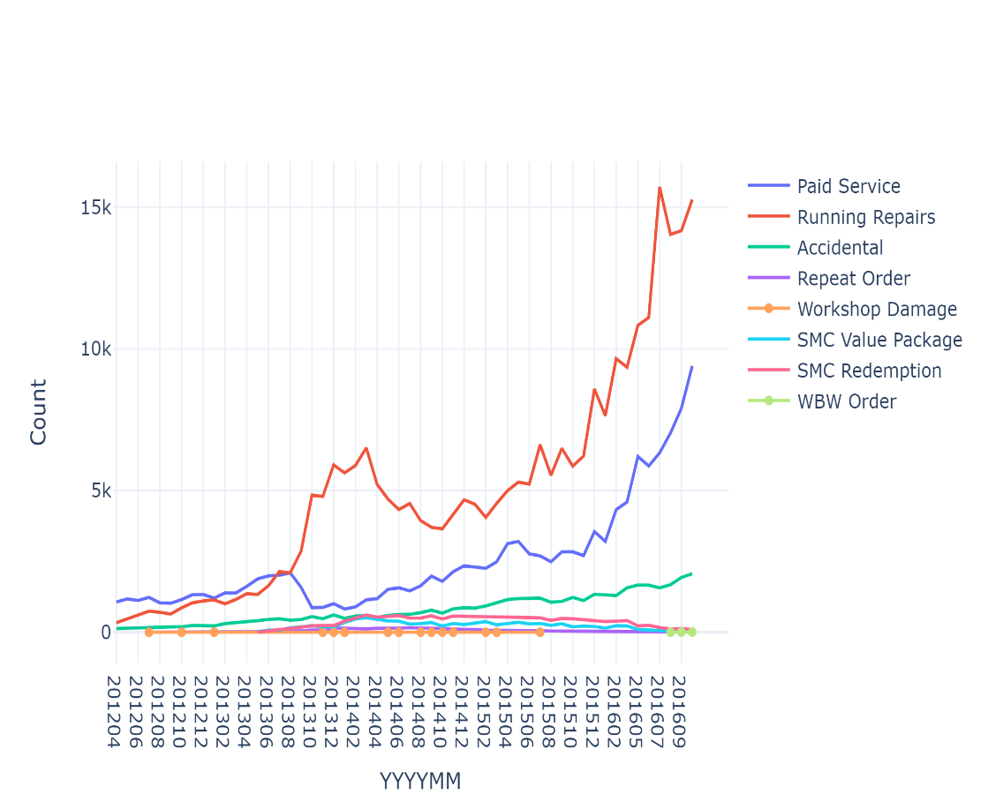
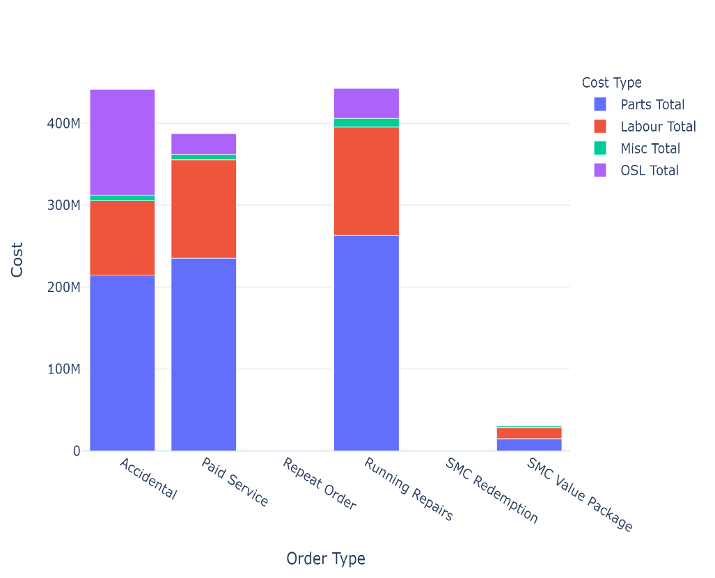
Cost for each order type
Cost for each order type
For all type of orders parts & Labor cost are maximum
For Accidental order type 25% of total amount goes towards outsourced work
For SMC and Repeated order type outsourced amount is 0
SMC package was introduced in May 2013

Slide 21
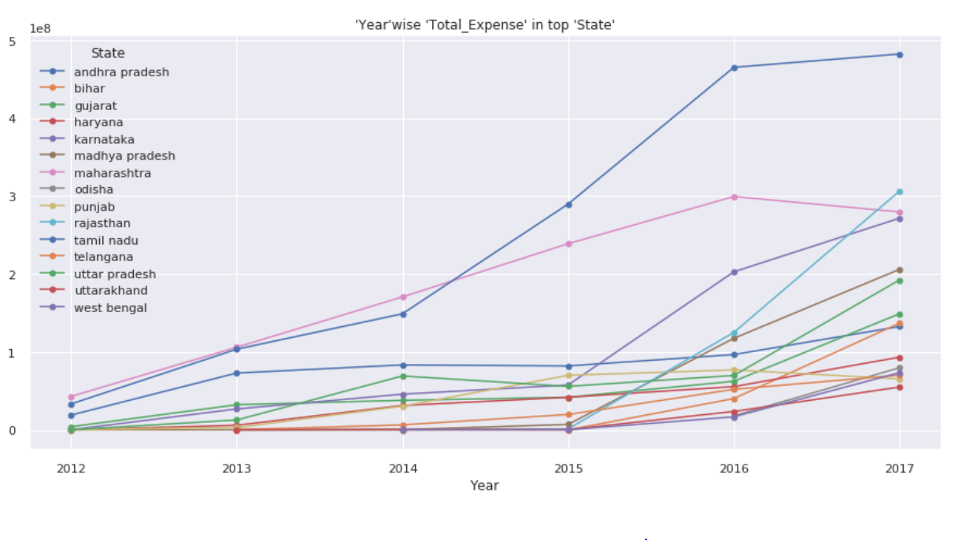
Data Analysis
Observation:
Uttarakhand has the lowest ‘Total_Expense’ but the ‘Tamilnadu’ has increase a lot from 2014 to 2016

Slide 22
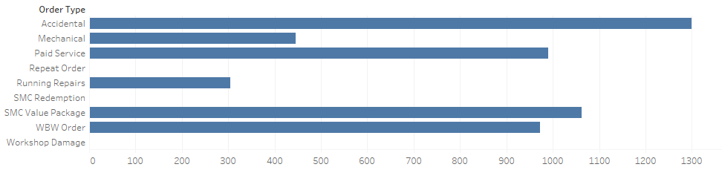
Difference in each service/labour costing
It depends on following factors:
Car Model (Make) : type of vehicle, size of vehicle & petrol type
Locality : The basic labor charge varies based on the location as the land cost varies.
Service type: cleaning, general checkup, Car washing, Alignment, Tyre rotation
Labour costing for the factor service type

Slide 23
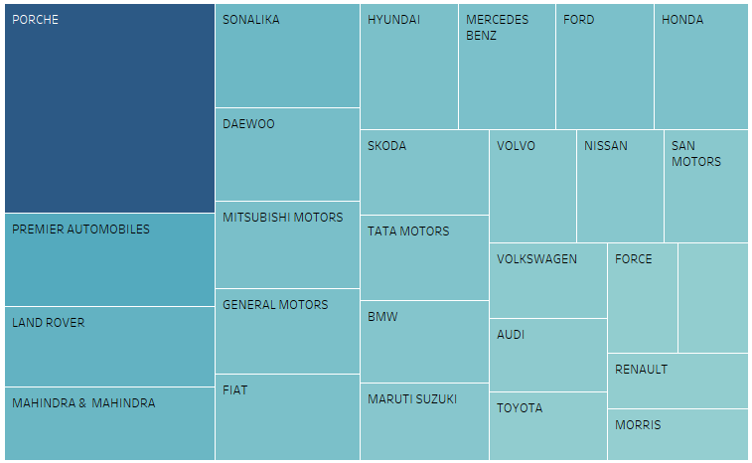
Labour Costing for the factor Make

Slide 24
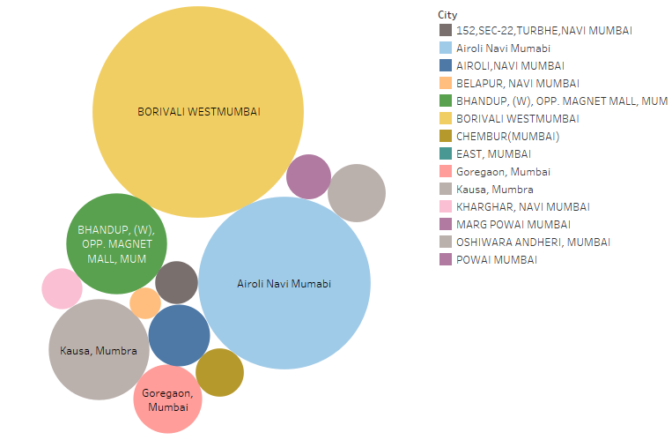
Labour costing for the factor Locality (areas in Mumbai)

Slide 25
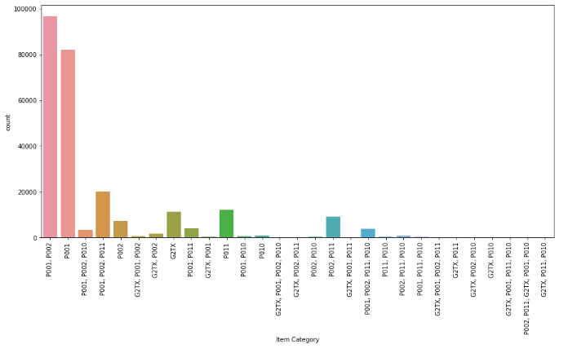
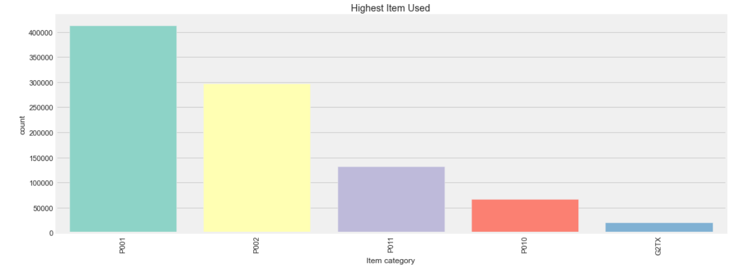
Popular items for Service orders
P001, P002 are the most popular items utilized for fulfilment of service orders.

Slide 26
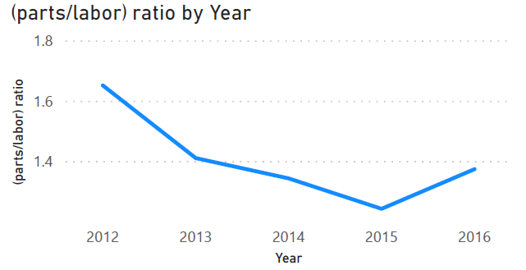
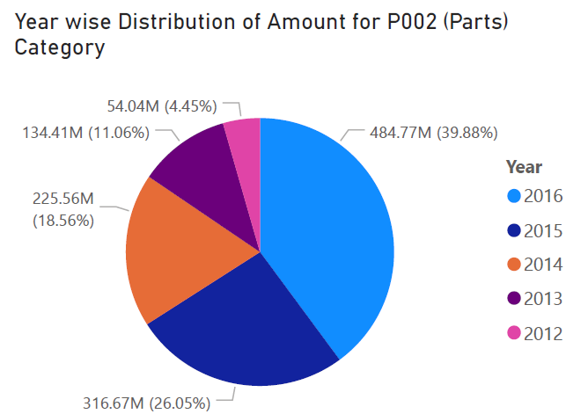
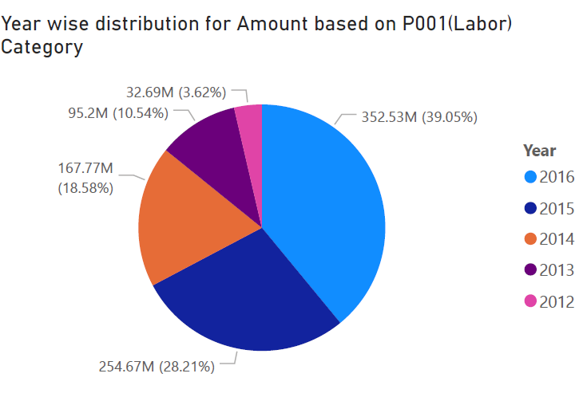


Parts To Labor Ratio

Slide 27


Is the service seasonal?
There is no pattern of customer increment in Monthly customer count
However there is 5PM-6PM is rush hour on daily basis
And on Sundays least numbers of customers comes

Slide 28

Spread of various amounts

Slide 29

Data Analysis

Slide 30


Inventory analysis : Top Inventory item
Mirror Service, Engine Oil and Oil Filter most used item for most of the states
Historically Oil Filter and Engine Oil are most used Inventory Items

Slide 31


Top Inventory item by Manufacturers & Order Type
Mirror Service, Engine Oil and Oil Filter most used item for most of the states

Slide 32


Efficiency Of A Plant
Efficiency was calculated Plant wise for each year & each month
Efficiency = (Total Revenue in a year / Total servicing time in hrs * Count of invoices) *100

Slide 33

Arima model – Revenue Forecast
Stationary??
It is non-stationary because mean and std is not constant

Slide 34

Transformations
Using differencing to make this time series stationary

Slide 35

Dickey-Fuller Test AND Rolling Test
* The results show that the test statistic is significantly less than the 1% critical value, as its stationary

Slide 36

Plotting ACF & PACF
In this p and q values can be determined as : p=1,q=1. This gives the optimal values for ARIMA model (p,d,q) which are (1,1,1)

Slide 37

Plotting Arima model with order(1,1,1)

Slide 38

Forecasting with Arima model (period = 12 months)

Slide 39


Prophet Model
Plot for Revenue
Plot for Log of Revenue

Slide 40



Basic & components Plots

Slide 41



Model Tuning

Slide 42



Market Segmentation

Slide 43
Cust Type | Average revenue | Average Servicing Hrs | Customers Count
0 | 5033 | 54 | 90718
Insurance | 4235 | 49 | 1
MFCWL | 6796 | 66 | 41
Retail | 4069 | 47 | 90676
1 | 15160 | 263 | 34529
MFCWL | 7085 | 131 | 10
Retail | 23236 | 395 | 34519
2 | 6212 | 74 | 52299
MFCWL | 7388 | 85 | 22
Retail | 5036 | 62 | 52277
3 | 6635 | 56 | 106671
MFCWL | 8533 | 68 | 40
Retail | 4738 | 44 | 106631
4 | 2941186 | 107 | 5
Fleets | 3335623 | 38 | 2
Retail | 2546749 | 176 | 3
5 | 25445 | 184 | 434
Corporate- M&M | 39127 | 207 | 73
Corporate others | 25047 | 149 | 173
Fleets | 32319 | 197 | 179
Franchise | 5285 | 184 | 9
Grand Total | 403684 | 127 | 284656

Slide 44




Rule Based Clustering

Slide 45



Slide 46

RFM Clustering
Customer are clustered based on there Recency, Frequency and Revenue
KMean clustering algorithm is used for clustering the users
We have clustered the customers in High, Mid and Low value clusters
High Level Approach
Using Elbow Method 4 clusters were selected for Recency, Frequency and Monetary
Overall Score = Recency Cluster + Frequency Cluster + Monetary Cluster
Customer clustering is done based on Overall Score

Slide 47
Customer Life Time Value Prediction
Customer lifetime value is a metric that indicates the total revenue a business can reasonably expect from a single customer account.
It is calculated as Average purchase frequency multiplied by Average spend per visit.
Considered 2015 year data.
Business can use this metric to increase ROI.

Slide 48

Feature Importance
We can see that Total Amount feature is of highest value followed by service time

Slide 49

LTV Classification
Classification Output
- Low Ltv Group (<3036)
- Medium Ltv Group( 3036 & 8801)
- High Ltv Group (>8801)

Slide 50


LTV Regression
Regression Output - Continuous LTV value

Slide 51
Value delivered to the business
For Accidental order type 25% of total amount goes towards outsourced work, repairing the some part can reduce outsourced work
There is no seasonally rush, but on daily basis 5PM-6PM are rush hours
Mid-Value customers are most revenue generating cluster
Recently we have been losing lots of High-Value customers
We Should Stock Engine Oil, Oil Filter since they are high demand items
Highest revenue & repairs during mid year (around July) -> Hire contract staff
Use less load day (i.e. Sunday) -> for training on soft skills & technical aspects
Major customer types are retail -> Work on tie ups with corporate & fleet (ola, uber, etc). Use corporate discounts & offers.
Investigate what are the reasons for decrease in revenue in the Plants present in state of Telangana , Uttar Pradesh
Please take feedback from Customers after service is given in for example (rating out of 5). Since it can be used to find the quality of service

